Slide 1
Binomial and Black Scholes Model for Option Pricing

Slide 2
OPTIONS AND DIFFERENT TYPES OF OPTIONS
Options are financial derivatives that provide the holder with the right, but not the obligation, to buy or sell an underlying asset at a predetermined price within a specified period.
They offer investors flexibility and the opportunity to hedge risks or speculate on future price movements without requiring the full capital outlay of owning the underlying asset.
European Options: These options can only be exercised at expiration.
American Options: These options can be exercised at any time before expiration.

Slide 3
TYPES OF OPTIONS
CALL OPTION
PUT OPTION
A call option gives the holder the right, but not the obligation, to buy the underlying asset at a predetermined price (the strike price) on or before the expiration date.
When an investor purchases a call option, they are betting that the price of the underlying asset will rise above the strike price before the option expires.
If the price of the underlying asset exceeds the strike price at expiration, the call option is said to be "in the money," and the holder can exercise the option to buy the asset at the lower strike price.
If the price of the underlying asset is below the strike price at expiration, the call option is "out of the money," and the holder may choose not to exercise the option, allowing it to expire worthless.
A put option gives the holder the right, but not the obligation, to sell the underlying asset at a predetermined price (the strike price) on or before the expiration date.
Investors typically purchase put options to profit from a decline in the price of the underlying asset. If the asset's price falls below the strike price, the holder can exercise the option to sell the asset at the higher strike price.
If the price of the underlying asset is above the strike price at expiration, the put option is "out of the money," and the holder may choose not to exercise the option, allowing it to expire worthless.
Conversely, if the price of the underlying asset is below the strike price at expiration, the put option is "in the money," and the holder can exercise the option to sell the asset at the higher strike price.

Slide 4
BINOMIAL MODEL
The Binomial Model is a fundamental options pricing model characterized by its discrete-time framework and binomial tree structure.
It divides time into discrete intervals, allowing for a step-by-step analysis of the underlying asset's price movement. The model represents possible future price paths of the underlying asset through a binomial tree, with each node depicting a possible price level at a specific point in time.
Central to the model is the assumption of risk-neutrality, where investors are considered indifferent to risk and make decisions solely based on expected returns. This simplifies calculations by using probabilities derived from risk-free rates.
Option values are determined through backward induction, starting from the final nodes of the tree and moving backward through the tree. At each node, the option value is calculated by discounting the expected future payoffs.
The model is flexible and versatile, capable of pricing various types of options, including American and European options, and accommodating complex features such as early exercise provisions and dividends.

Slide 5
BLACK-SCHOLES MODEL
The Black-Scholes formula, developed by Fischer Black, Myron Scholes, and Robert Merton, revolutionized the way options are priced in financial markets.
It provides a theoretical framework for determining the fair value of European options, which are contracts that allow the holder to buy (call option) or sell (put option) an underlying asset at a predetermined price within a specified timeframe.
The formula considers key factors such as the current stock price, the strike price, the time remaining until expiration, the risk-free interest rate, and the volatility of the underlying asset.
By assuming a log-normal distribution of asset returns, no dividends, and constant volatility, the formula calculates the theoretical price of the option.
This price serves as a reference point for investors and traders to evaluate trading strategies, assess risk, and make informed decisions in the options market.

Slide 6
REAL WORLD APPLICATION
We check both the models application for the APPLE stock
INSIGHTS FROM OUR DATA
The annual volatility is : 0.1935719432079699.
The put price when the binomial option pricing model is used is : 1.4048790252179348
The call price when the binomial option pricing model is used is : 26.58838794850725
The Call price when the black scholes formula is used : 26.49986592344878
The Put price when the black scholes formula is used : 1.316357000159627
Implied volatility: 0.010231182072694134

Slide 7
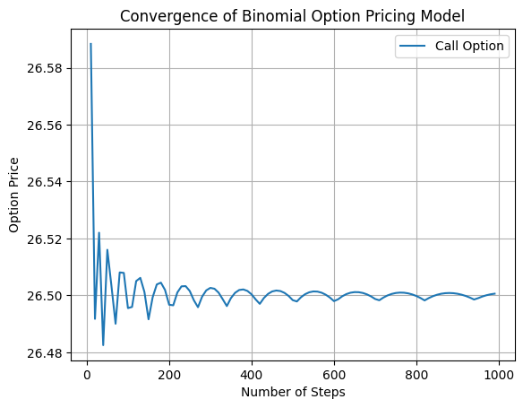
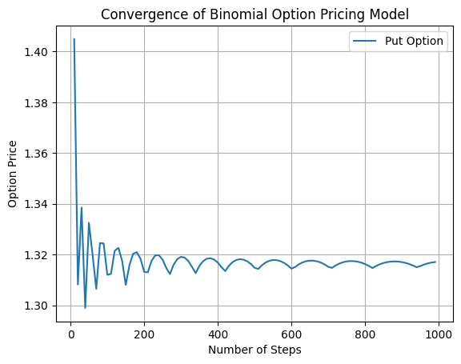
CONVERGE GRAPHS

Slide 8
CONCLUSIONS
The comparison between the Binomial Option Pricing Model and the Black-Scholes Formula, alongside the derived implied volatility, provides intriguing insights into option pricing dynamics and market sentiment.
With the annual volatility set at 0.1936, both models produce remarkably similar results: the Binomial Model yields a call price of $26.588 and a put price of $1.405, whereas the Black-Scholes Formula outputs $26.500 for the call and $1.316 for the put.
These close price alignments underscore the robustness of both methodologies in estimating option values. However, it's noteworthy that the Black-Scholes Formula's implied volatility, calculated at 0.0102, suggests a subdued expectation of future volatility in the market.
This alignment between model-derived prices and market sentiment not only aids traders in crafting informed strategies but also underscores the importance of understanding and interpreting implied volatility as a crucial market indicator.

